Slide 1



Online bookstore
SINGLE PAGE APPLICATION
Jaeson Karter Joseph -BFL

Slide 2

Description
A Secure SPA Online Book Store that lets you buy, rate and leave your comment for all the books that are available in the store. You can also see all your purchased book's history or create your own favorite books list.
Integrate Front End and Back End
Implement a Real-World Application
Implement End to End Project
Implement Security Features
Actions Based on Roles (Admin/User)
Validation of all User Input Forms
Understand and Implement the Core Features of Angular
Implement API Calls
Fetching Backend Using API
Data Storing and Handling
GOALS

Slide 3


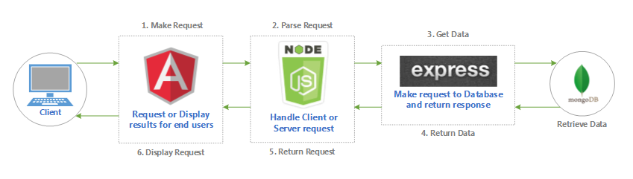
TECH STACK : MEAN

Slide 4
core concepts of building SPA WITH Angular
• Wrapped each major feature into a module
• Lazy-loading for most of the modules so the app can start faster
• Shared module for components, directives and pipes that can be imported into any feature module
• Services for each major feature
• Custom directives
• Custom pipes
• TypeScript models
• Reactive forms for handling user input with validations
• Responsive
• Interceptors

Slide 5




FEATURES
-Most Purchased Books
-Best Rated Books
-Newest Books
-Payment Gateway
Core
- Add books to the store
- Edit books
- Delete books
- Edit/Delete offensive user comments
- Block/Unblock user from commenting
- Change unappropriated user avatars
Admin users
- Buy books
- Rate books
- Comment books
- View user profiles
- View his own purchases history
- Create favorite books list
- Can change his own avatar
Authenticated users
- Login/Register
- View all books
- View books details, rating and comments
Anonymous users

Slide 6

LIBRARIES USED
BOOTSTRAP
CRYPTOGRAPHY
CORS
VALIDATOR
JWT
RXJS

Slide 7
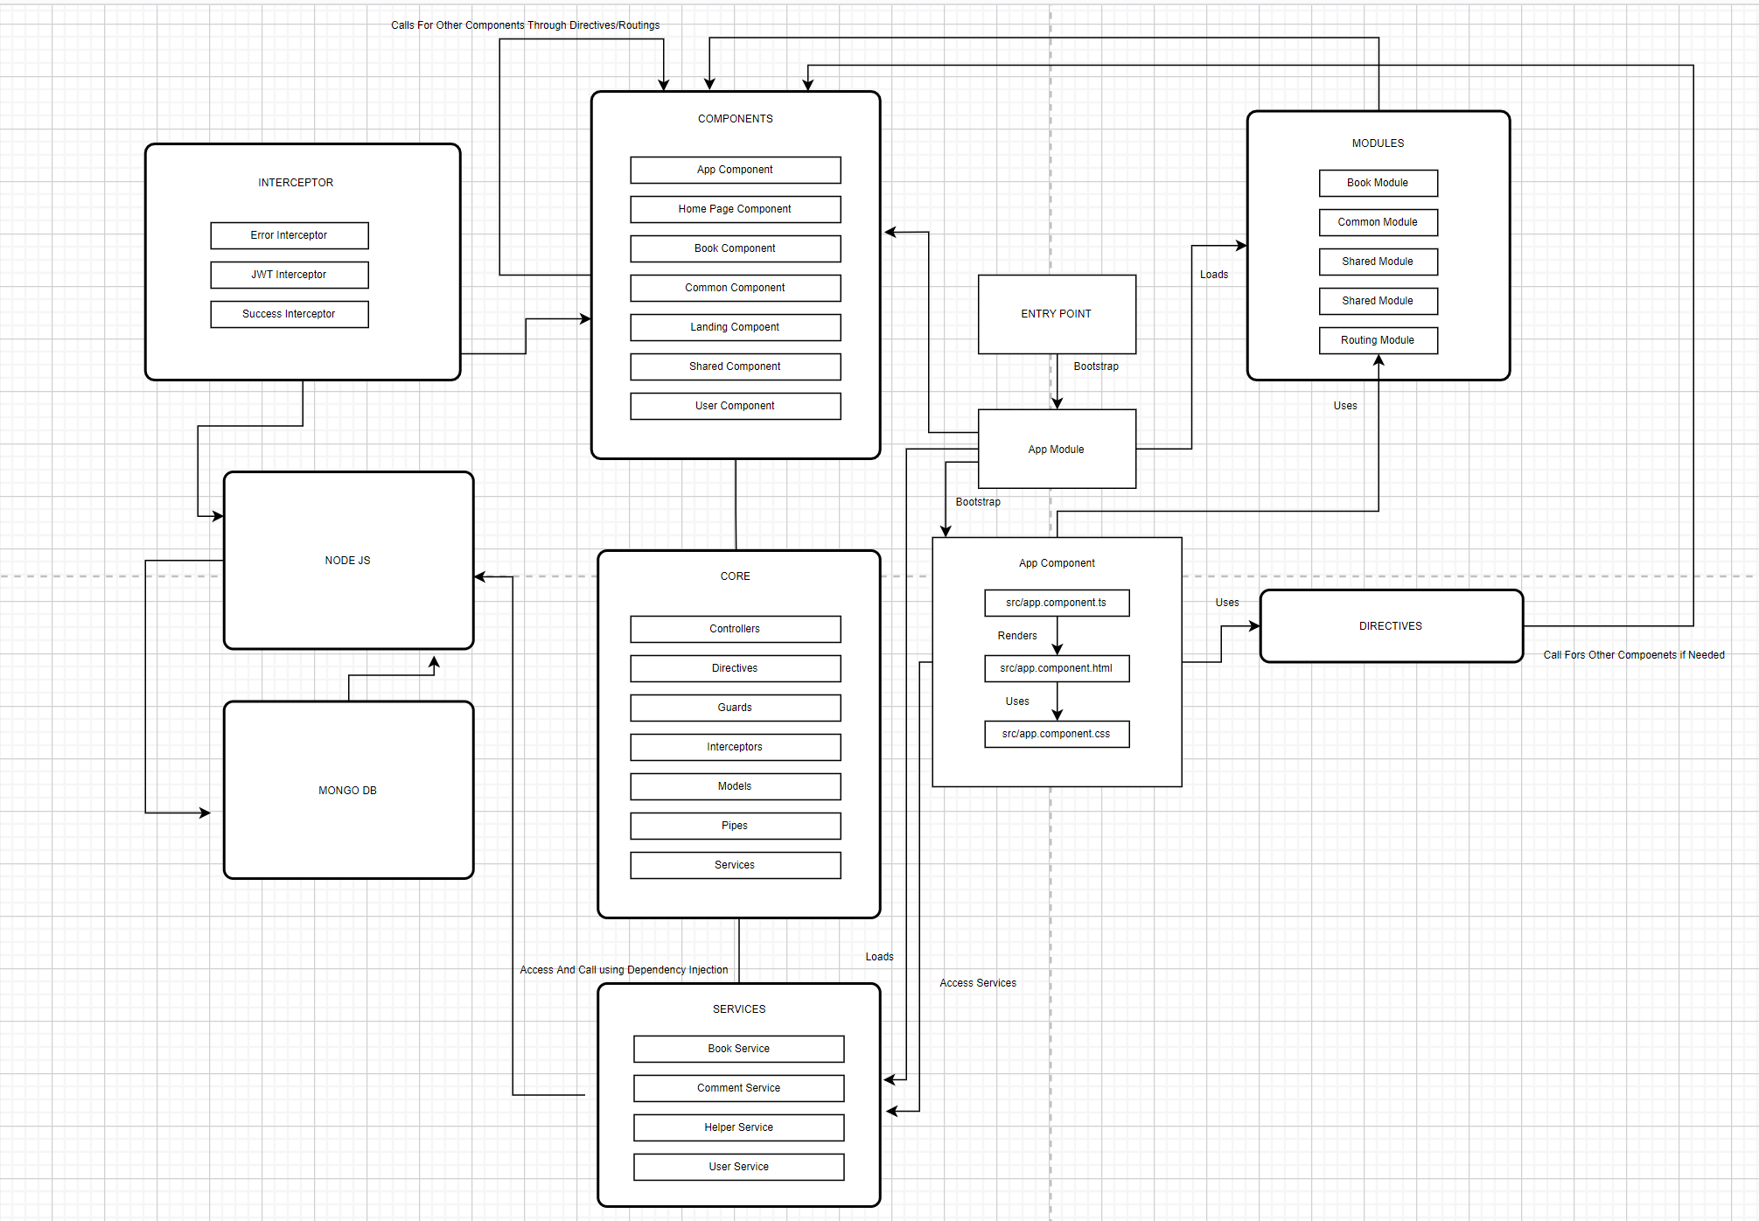
Project ARCHITECTURE

Slide 8
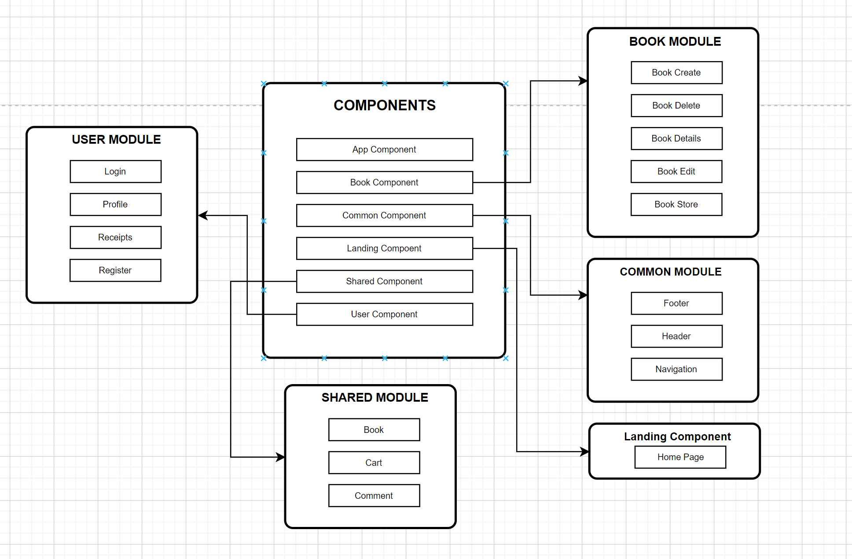
COMPONENT ARCHITECTURE

Slide 9
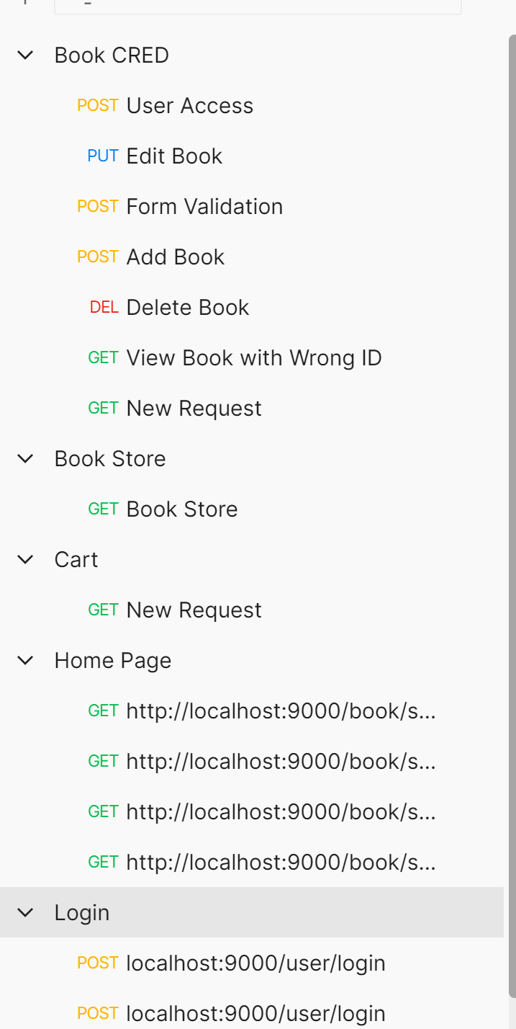
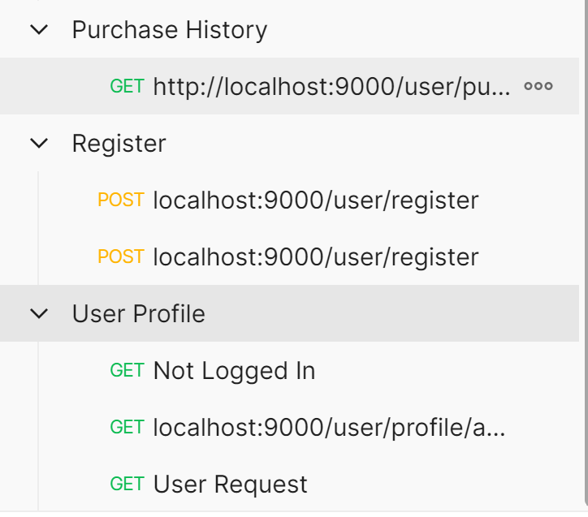
POSTMAN API CALLS
*API Details in Documentation

Slide 10
THANK YOU

